Slide 1


Encouraging confidence in public office & public institutions

Slide 2

Commissioner, Dr Nikola Stepanov JD, PhD (Melb.)
Local Government & Integrity
integrity.commissioner@integrity.qld.gov.au

Slide 3

Integrity Commissioner
Who we are
Statutory Office Holder & Officer of Parliament
Reporting relationship: Speaker of House & Parliamentary Economic and Governance Committee
Impartial and independent- allows for frank and fearless advice
Convenor & Chair, Integrity Committee:
  Chair of Crime & Corruption Commission, Auditor-General, Ombudsman, Commission CEO PSC, Information Commissioner, Electoral Commissioner, Racing Integrity Commissioner, Independent Assessor
Functions s.7:
  Provision of advice to ‘designated persons’ on ethics & integrity issues (5000+ people)
  Lobbyist register & regulation
  Raising public awareness
  Standard setting at request of Premier

Slide 4

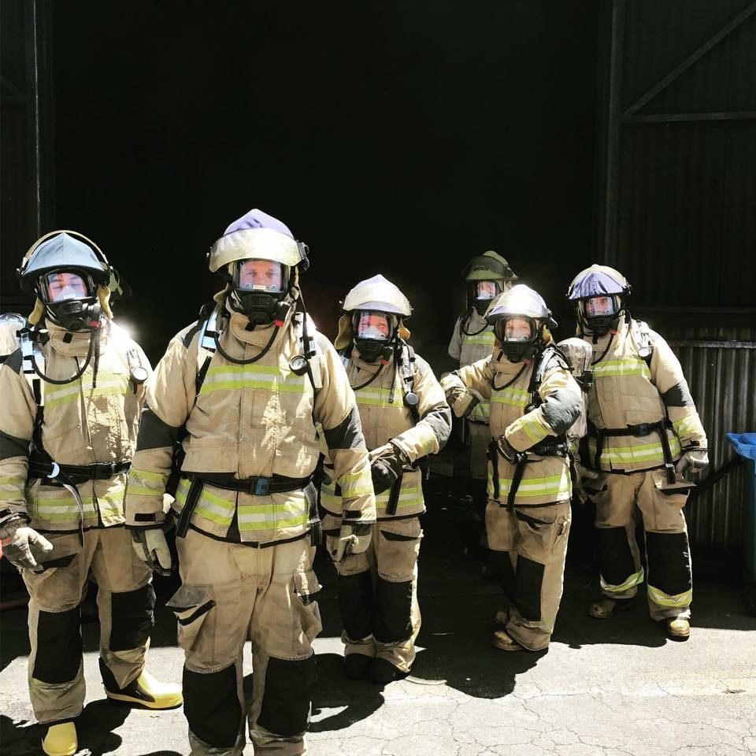
Integrity Commissioner
Public Awareness Function
Integrated approach with Integrity Committee members
Workshops & seminars, i.e. local council workshops, integrity and culture workshops, procurement and business dealings
Review policies, processes, standard setting
Parliamentary submissions

Slide 5
Integrity Commissioner
Advice Functions
Confidential advisor to 5000+ ‘designated persons’:
  All Ministers & Members of Parliament
  All statutory office holders (1900+ Boards, Commissioners, inc. Administrator, Ipswich CC)
  Ministerial staff
  All Directors-General & DDGs or equival.
  All Chief Executives
  All Senior Executives, Senior Officers
  Other groups nominated by Ministers, i.e. Mayors & Councillors (12(1)(h)) effective 5 February 2018- in response to recommendation 28(a) of the Belcarra Review

Slide 6
Integrity Act 2009
Protection to Designated Person, s.40(1)-(3)
(1) Designated person:
      (a) Seeks advice
      (b) Discloses all relevant information
      (c) Does an act to resolve the conflict substantially in accordance with QIC advice
(2) Not liable in a civil proceeding or under administrative process for the act taken to resolve the conflict (put advice into effect)
(3) Does not effect liability for act or omission done or made before QIC advice

Slide 7
Integrity Act
Secrecy
A person must not record, use or disclose information in relation to an ethics or integrity issue about another person that came to the person’s knowledge because of the person’s involvement in the administration of this chapter. *
…
(3) A person who is or has been involved in the administration of this chapter is not, in any proceeding, compellable to disclose information in relation to an ethics or integrity issue about another person that came to the person’s knowledge because of the person’s involvement in the administration of this chapter.
*Breach: offence punishable 1 year imprisonment or 85 penalty points per breach
*However, whilst I cannot comment on any particular case, I can be asked to provide expert testimony

Slide 8
Integrity in Public Office
Doctrine of public trust
Public responsibilities exercised in the public interest and not for the private interests of the office-holder
In recognition that public office involves public trust, office-holders will:
  Promote public confidence in the integrity of the public sector
  Acknowledge the primacy of the public interest

Slide 9
Integrity Commissioner
Advice must provide strategies to resolve matter in favour of public interest (not the advisee’s own interest)
Objective test- reasonable person, fully informed of facts (…not pub test or local news test)
Confidentiality provisions allow for people to seek advice when there is uncertainty, and find an appropriate, public-centred resolution
Typically QIC advice will bring about some personal or professional detriment to the interests of those whom QIC advises
i.e. making a choice that goes against their own personal interests- sell shares, resign as office bearer or other employment, not take part in a decision where there is a genuine professional interest as well

Slide 10
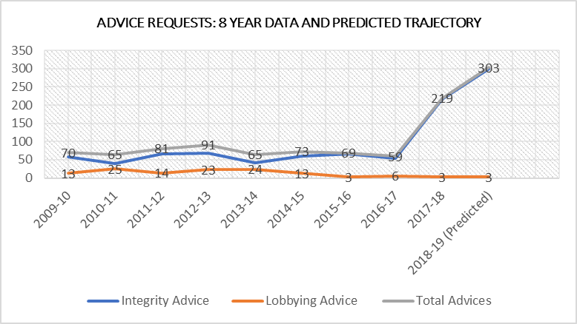
Integrity Commissioner
Radically changing landscape
Usually 40-64 per annum (avg. 58)
2017 FY: 216 (four-fold increase)
Month June: 51
Predicted for 2018 FY: 300-600 (360-400)
Growing profile in prevention space
Heightened ethical climate and greater commitment to meeting public’s expectations

Slide 11
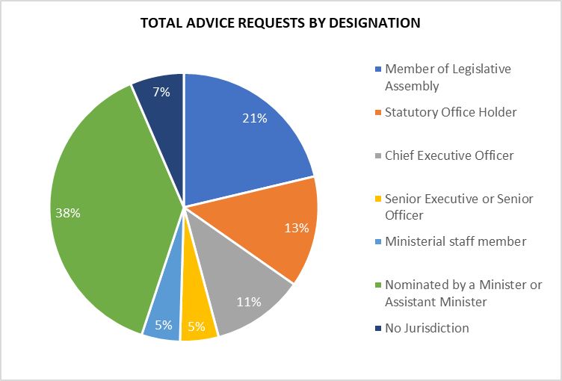
Integrity Commissioner
Trend
Quarters 1-3:
Members of Parliament: Ministers & Assistant Ministers (inc. if relevant Premier)
Statutory Office Holders
Quarter 4:
1. 75% of all requests Mayors and Councillors

Slide 12
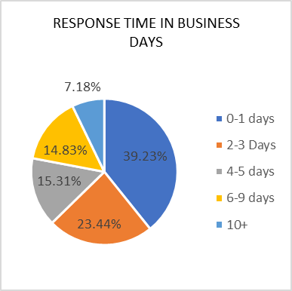
Integrity Commissioner
Minimal impact on response times.
- principal reasons for responses taking more than three business days were:
  · the request involved complex issues requiring detailed
  research or consultation, and
  · further information being sought by me
- there is only one of me, so allow three – five days if possible!

Slide 13
Integrity in Local Govt
Main issues or requests (LGA)
Personal Material Interests (ss175B, 175C)
Conflicts of Interest (ss175D, 175E)
Other probity matters inc.
  when councillor’s term ends, i.e. running for another office (s160)
  use of confidential information (ss171,171A)
  obligations to report suspicion or belief of another’s PMI or COI (s175G)
  Offence to take retaliatory action or influence (ss175H, 175I)

Slide 14
Integrity Commissioner
Main subject matter, Local Government
shareholdings, property ownership, and proposed developments
managing the consequences of accepting donations
acceptance of hospitality, gifts, and other benefits
potential conflicts arising due to employment or business interests (councillor or related party)
rights as an ordinary member of the community while holding senior public service role or public office

Slide 15
Integrity in Local Govt
Personal Material Interest
Section 175B of the Local Govt Act (LGA)
Definition including who/ what it applies to (i.e. your related parties and other entities)
Mechanism to resolve is in section 175C
Currently onus on you to recognise (unlike COIs)
Offence if you do not manage appropriately
If in doubt, seek advice from me or independent advice
Note: Independent advice does not carry protections of Integrity Act 2009
I am not obliged to find a mid-way solution with outside organisations- not a mediation process

Slide 16
Integrity in Local Govt
Conflicts of interest
Conflict between personal interests & public duties
Conflict between public duties & other roles you have
Standard, Integrity Act 2009:
  Reasonable person, fully informed, would perceive there is a conflict
Judged objectively
Inappropriate for individual to make determinations about own circumstances as has vested interest in the situation
Conflict less important than how it is managed

Slide 17
Integrity in Local Govt
Conflicts of Interest
For a conflict of interest to arise, the situation would need to be one where:
  You have a specific official responsibility which a reasonable person may consider might be influenced by your personal views/ interests; or
  Where a reasonable person might perceive that you might intentionally or unintentionally seek to influence a particular official decision; or
  Where a reasonable person might perceive that because of your personal views you would be unable to bring an objective mind to a discussion or decision
  May result in a decision that is contrary to public interest

Slide 18
Integrity in Local Govt
Conditions
You have ‘interest’
A conflict arises when you have to make an official decision, or carry out an official obligation etc.
Factors
What are the benefits or losses? To who/m? How significant and realisable are they?
Directness/ remoteness of benefit or loss and to whom/ who
Class of persons who will realistically benefit/ experience detriment
Actual ability to influence a decision to benefit self or to detriment of anon.
(I rely on precedents for consistency in my determinations- allows for standard-setting across)

Slide 19
Integrity in Local Govt
Resolution
PMI
no other mechanism under LGA- declare & leave
Interest or COI
Declare & leave
Declare & discuss
LGA empowers Councils to discuss & set standards
Must be generalisable- advised to use same approach/ factors each time

Slide 20
Integrity in Local Govt
Quorum
Not quorate?
form Standing Committee of unconflicted members for significant matters
allows elected members to make decision (& enables community representation)
actualised CoI when councillors who vote as a block do not enliven this option (i.e. decision-making taken away from the powers of the voting block)
delegate less significant matters to CEO

Slide 21
Integrity in Local Govt
Other Obligations
s. 175G- duty to report suspicion or belief of another councillors’ PMI or COI
s. 175H- no retribution for this
s. 175I- do not influence
When does a matter become a ‘matter’ before Council?
does not need to be before Council (i.e. an active application) for offence of influencing to kick in….
untested area of law- not settled- err on side of caution

Slide 22
Integrity in Local Govt
Most common factor in corruption and misconduct
Undisclosed conflicts of interest
Most commonly uncovered via
Tip offs arising form chance
Most crucial component to prevent corruption
Culture at the top
Doctrine of public trust
Public responsibilities exercised in the public interest and not for the private interests of the office-holder
Public officials must
Promote public confidence in the integrity of the public sector
Acknowledge the primacy of the public interest

Slide 23
Integrity in Local Govt
Preventing misconduct and corruption
Requires commitment and vigilance
Requires honourable conduct and personal integrity
Requires awareness of responsibilities
Requires environment where openness and reflective practice are encouraged
Requires a willingness to step forward with concerns, and implement strategies to resolve matters appropriately
Requires that we dispel a few myths….

Slide 24
Integrity in Local Govt
Dispelling some implausible myths
Integrity issues are black and white
Common sense will prevail, and it is so common we all have enough of it… all of the time
We can all recognise the effect of our own vested interest- and make decisions counter-intuitive to our own interests
The personal interests of others whom we have relationships with never stop us from being objective
I/ We know what ‘our community’ want or need, always
I/ We have a better understanding of the situation because …[insert subconscious bias/ irrational rationale/ self-interest here]
Conflicts of interest result from a weakness in personal character or inability to manage own affairs

Slide 25
Integrity in Local Govt
Contact Us
Email: integrity.commissioner@qld.gov.au
Phone: 07 30032888 or +61 428 233 630
Office: office@integrity.qld.gov.au
Lobbyist enquiries: lobbyistsregister@integrity.qld.gov.au

Slide 26
Developed by the Queensland Integrity Commissioner
⁽⁰⁷⁾ ³⁰⁰³ ²⁸⁰⁰
Integrity.commissioner@integrity.qld.gov.au

